Slide 1
Used car Price Prediction
By: Vikas Nagulapelly
Prof: Chaojie Wang

Slide 2
Introduction
In today's data-driven world, understanding the factors that influence used car prices is crucial.
Our project aims to provide insights into the dynamic market of used cars by leveraging machine learning.
As potential buyers and sellers navigate this market, having accurate price predictions becomes invaluable.

Slide 3
Background
The used car market is dynamic, influenced by various factors such as the condition of the vehicle, its age, odometer, model, and other features.
Exploring this project provides us with an opportunity to tackle a complex problem and offer valuable insights to both buyers and sellers in the used car market.
Access to the right information can help anyone make informed decisions and find good deals

Slide 4
Research Questions
Identify the trends in the sales of cars over the years.
01
Investigate the correlation between car price and its specifications.
02
Predict the price of a used car based on its specifications.
03

Slide 5
Data Source
The data for this project was scraped from the website Craigslist.
Craigslist is one of the largest advertisement websites for viewing and posting local advertisements, covering various categories, including housing, job postings, items for sale, services, and personals.
Data Size: 1.45 GB
Data Shape: 426,880 rows, 26 columns

Slide 6
Data Preprocessing
Odometer Range Selection:
To focus on majority of the dataset, we restricted the odometer reading to the range of 1,000 to 40,000. This decision was based on the observation that 85% of the data falls within this range, ensuring a more representative analysis.
Feature Selection:
Out of the 26 columns in our dataset, a careful analysis led us to drop 13 columns that were deemed less influential in predicting used car prices. Feature selection is a crucial step to enhance model performance and reduce dimensionality.
Age Calculation:
Originally, we had a "year" column in our dataset. To provide a more meaningful feature for predicting car prices, we calculated the age of the car by subtracting the year of manufacture from the current year. This transformation captures the car's age, a potentially crucial factor in determining its market value.

Slide 7
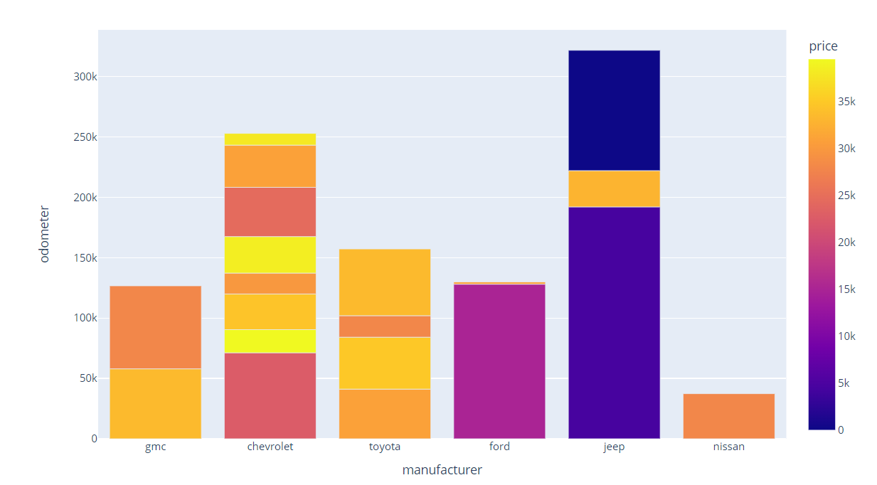
Data Vizualization
The interactive plot showcases the relationship between odometer readings and prices for different car
brands. It suggests that vehicles with higher odometer readings tend to have lower prices, while those
with lower odometer readings command higher prices. For instance, Jeep, with the highest selling
odometers, exhibits the lowest prices, while Chevrolet, with a narrower odometer range, commands
higher prices.

Slide 8
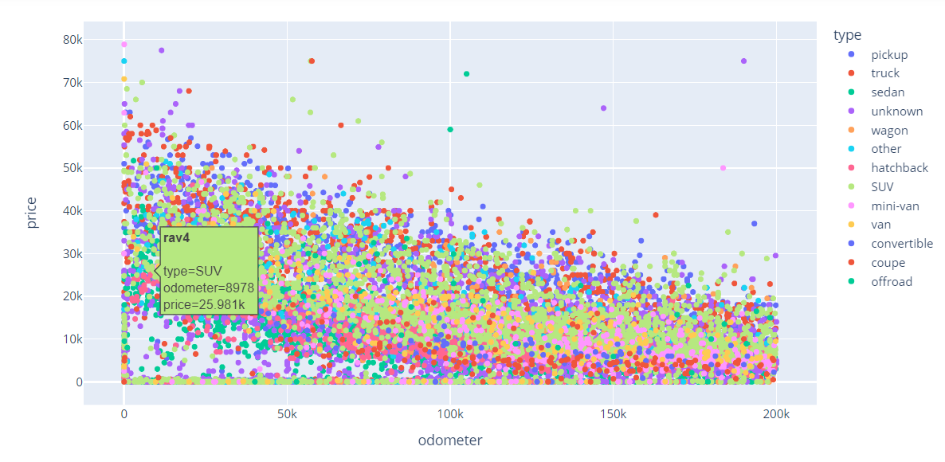
Data Vizualization
The interactive plot showcases the relationship between odometer readings and prices for Toyota car and
their types. For Toyota cars, buyers are willing to pay higher prices for trucks, even though the majority of
buyers prefer SUVs over other car types.

Slide 9
Model Training
Decision Tree Model:
We initiated our modeling with a Decision Tree algorithm, a versatile and interpretable model. Decision trees partition the data based on feature values, making them well-suited for our diverse dataset.
Grid Search CV using Decision Tree:
Recognizing the importance of fine-tuning hyperparameters, we employed Grid Search Cross-Validation. This approach systematically explores a range of hyperparameter combinations for the Decision Tree, enhancing its predictive performance.
Random Forest Regressor:
Building on the success of Decision Trees, we extended our modeling to Random Forest Regressor. This ensemble learning technique combines multiple decision trees, providing a robust and accurate prediction of used car prices.

Slide 10
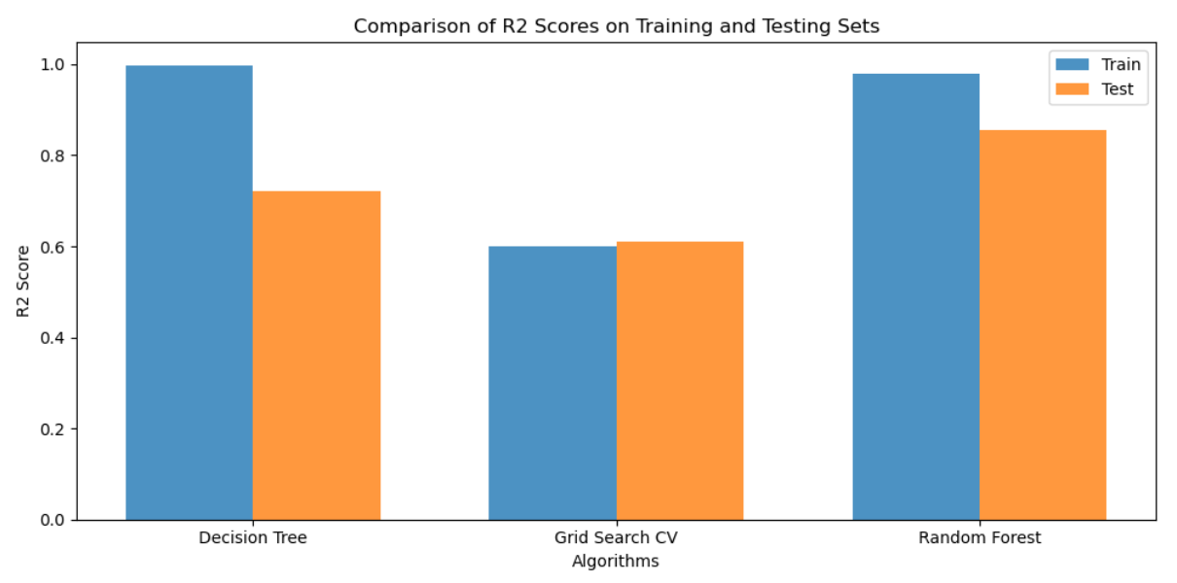
Model Comparision

Slide 11
Conclusion
In summary, our project achieved significant success in accurately predicting used car prices. The models, including Decision Tree, Grid Search CV using Decision Tree, and Random Forest Regressor, demonstrated robust performance, providing valuable insights into the dynamic factors influencing pricing.
The emphasis on data preprocessing ensured a refined dataset for training, contributing to the models' effectiveness. The practical implications of our findings extend to both buyers and sellers, fostering a more transparent and informed used car market.
Looking forward, the project's future scope involves expanding datasets, exploring advanced modeling techniques, and refining user interfaces for broader accessibility.

Slide 12
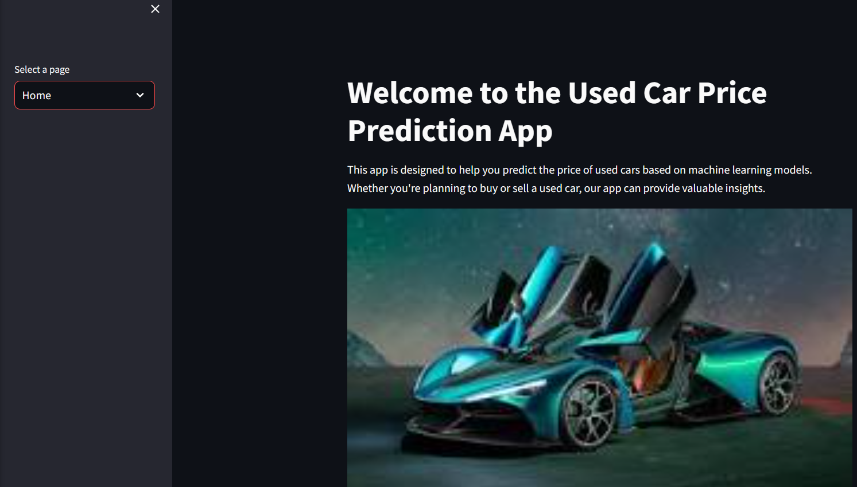
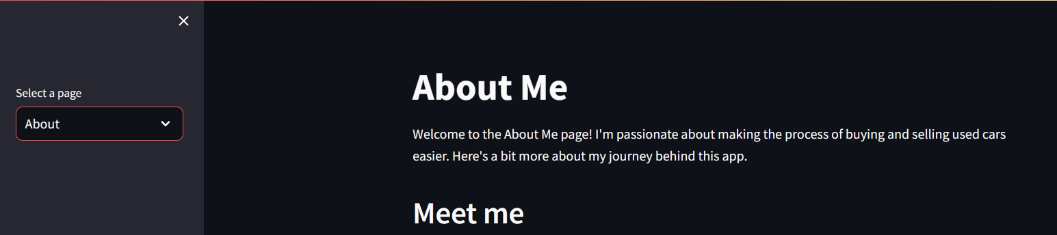
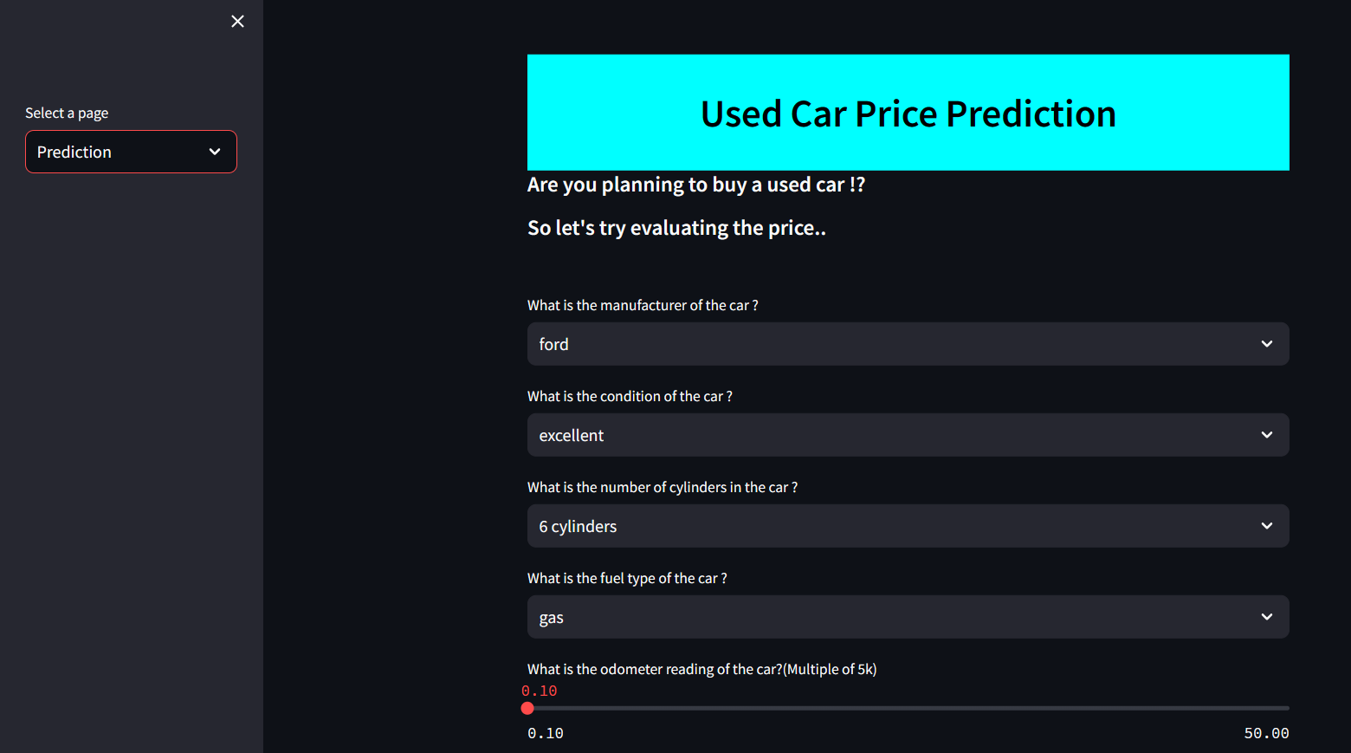
Our Web App

Slide 13


